Slide 1
Therapeutic ToucH®
Engaging the Public: Bringing Therapeutic Touch
into Community-based practice
Notes:
https://www.canterbury.ac.nz/education/world-of-possibilities/hands-holding-world-globe_DPC_block.jpg

Slide 2
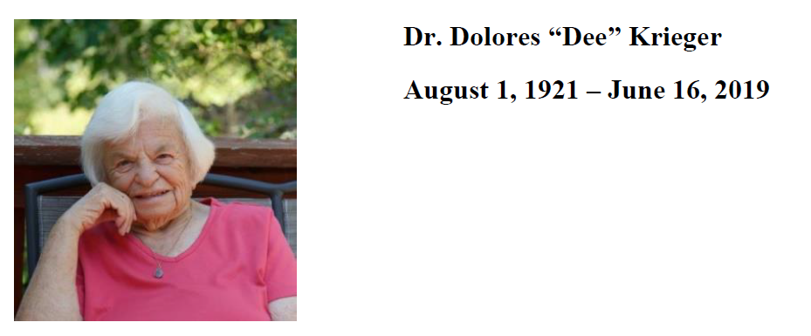
“She will be missed by healers all over the world. Her legacy is a living one.”

Slide 3
Our Objectives for today
To highlight some of the resources of the “Therapeutic Touch Awareness Week” pilot project that began in 2017 across the province of Ontario.
To encourage delegates to reflect on how TTAW resources and experiences may guide or inform their own community outreach needs.
To explore what outreach strategies may be sustainable and practical on a local, national and/or international scale?
Participants will leave with resources and tips to bring back to their own TT Branches and practice.
.

Slide 4
Therapeutic Touch Awareness Week CARE150
2017 – 2019
2019 TTAW Task Group
Michael Georgie – Program Lead
Jim Metson – Newsletter Editor
Alison Cooke – Webmaster
Suzanne Hale – Social Media
Jean Riddell – Secretary
*Deborah Gould - Communication Chair TTNO
Support Team – 9 province wide Regional Team Leads

Slide 5
Therapeutic Touch Awareness Week
2018 2019
First week of May aligns with:
Nurses, Hospice Palliative Care, Mental Health Weeks

Slide 6
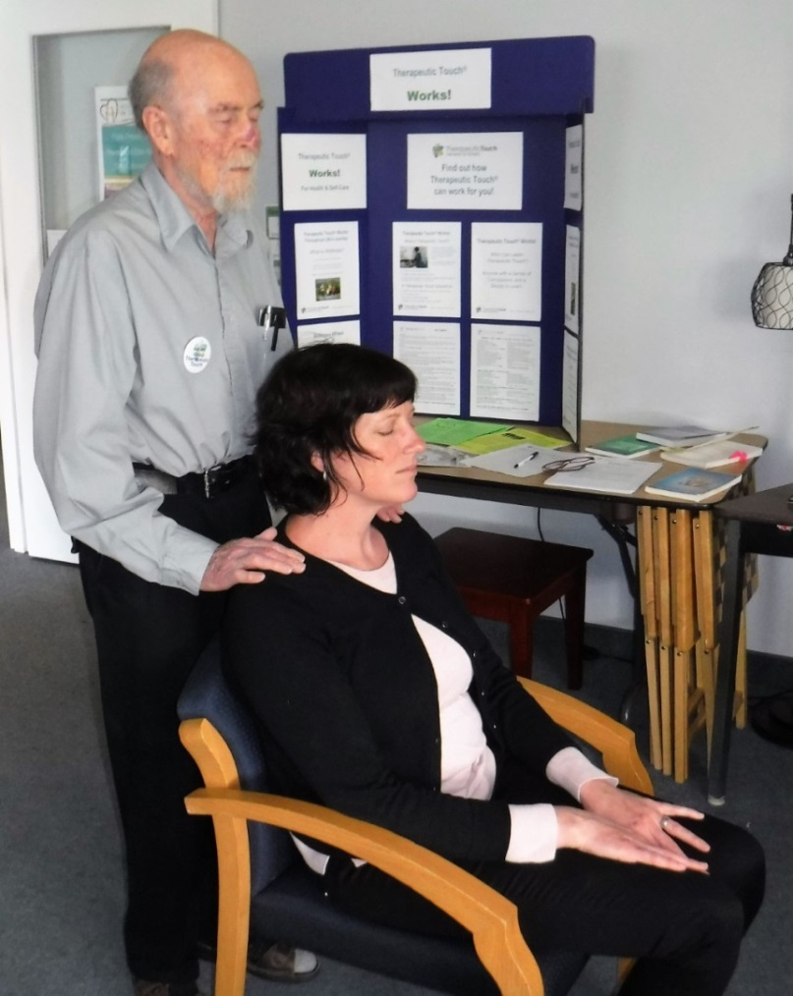
Resources & Tools to host a successful program

Slide 7
Project Objectives
Increase Therapeutic Touch Network of Ontario (TTNO) member engagement
Promote awareness of Therapeutic Touch® in our communities
Promote awareness of the TTNO as our regulatory body
Add Regional Team Leads (RTL) to strengthen structure and support Event Leads
Consistent branding/messaging
A financially sustainable initiative

Slide 8
Each year the TTAW Task group would:
Survey our membership for their input & feedback
Task Group aligns to meet by teleconference biweekly (representation across the province)
Create timelines for upcoming year and new documents based on needs
Review objectives and goals, resources updated as needed
Track and post all registered events; offering incentives to early registrations, CARE150 Challenge (aspects/uses & benefits of TT)
Communicate with membership via e-blasts, newsletter, website, Facebook, Press Release from Oct – May
Report monthly to the BOD and provide an Executive Summary at the end of the program identifying outcomes, recommendations and ‘take aways’

Slide 9
Therapeutic Touch Awareness Week (TTAW) coincides with: National Nurses Week Mental Health Week National Hospice Week
Most events are hosted in:
Hospitals Hospices Long Term Care
Libraries Churches Schools Health Centres

Slide 10
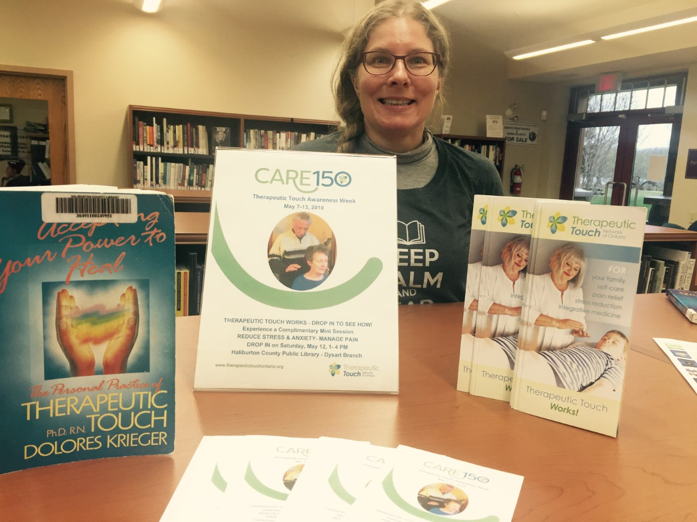
Haliburton Highlands Public Library- Dysart Branch A living Legacy of books

Slide 11
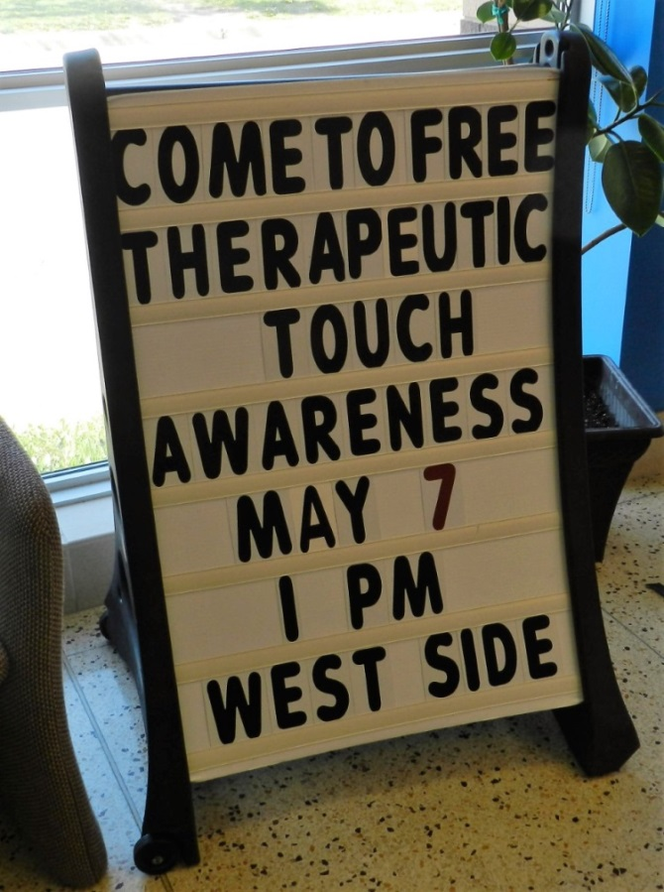
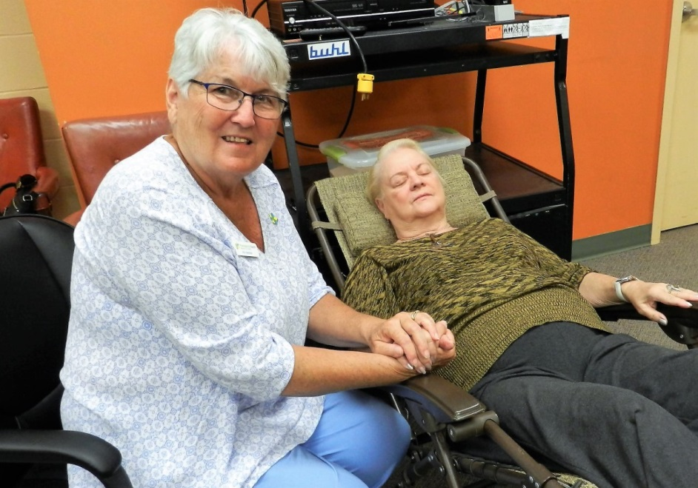
Windsor 16 Events with 211 TT sessions 37 volunteer practitioners 22 new students

Slide 12
High Skills Major program “Health & Wellness”
High Schools have a Health and Wellness component that aligns well with Therapeutic Touch®; streaming students that are looking into careers in Health Care field
Contact the school in your area and reach out to their coordinator (list on website)
A wonderful demographic to teach self care for sports injuries, exams, relationships and overall mental health

Slide 13
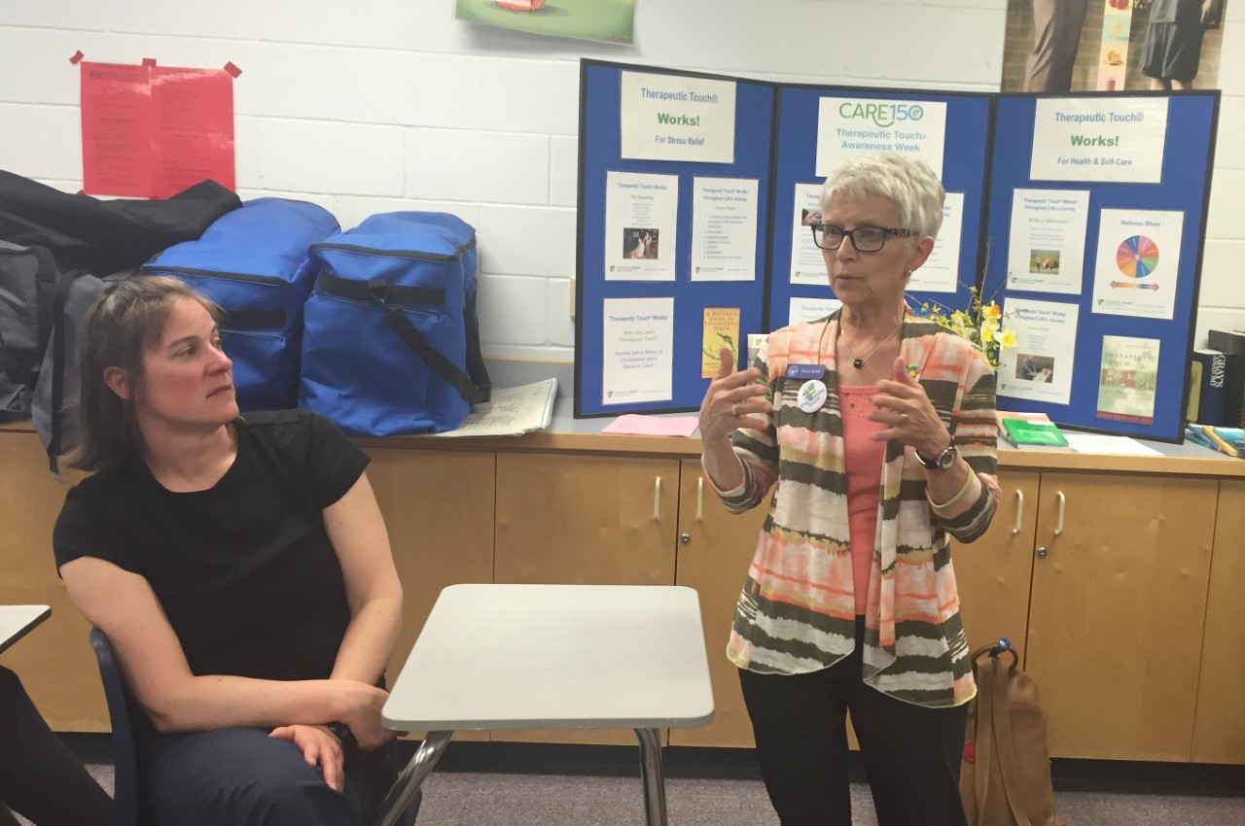
Kinesiology Class Haliburton – The next Generation

Slide 14
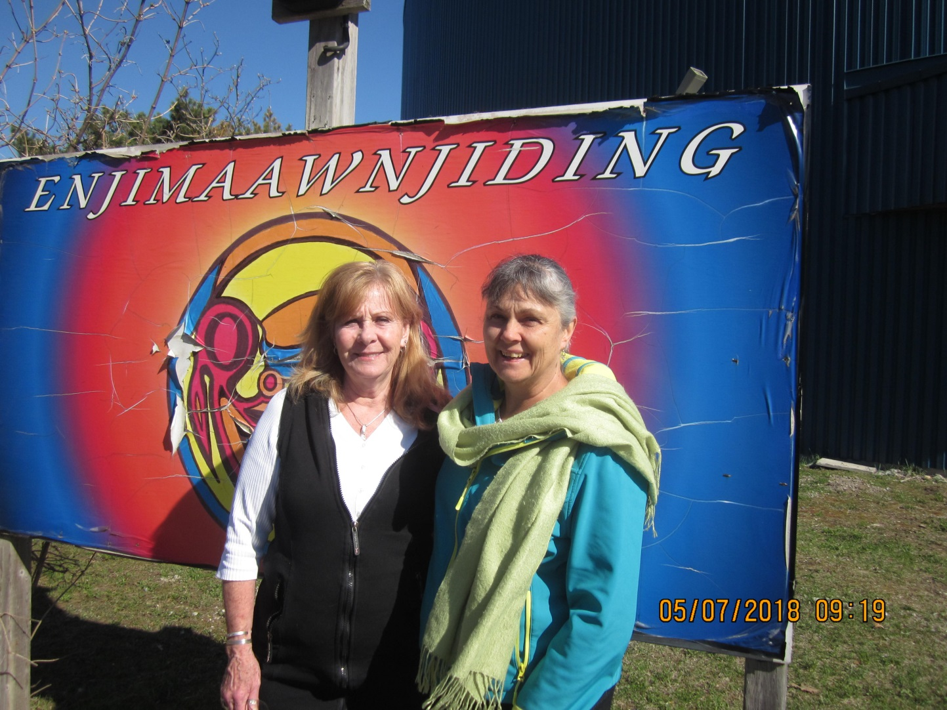
TT now Offered in Beausoleil First Nations Health Unit

Slide 15
4 Hospitals in Ontario
Supported TTAW events during Nurses’ Week= Sick Kids - Guelph General - St. Francis Memorial - Humber River Regional
Some for the second year in a row
2018 was the first year TTAW (Fergus/Guelph) & Hospice Wellington presented collaboratively at GGH
Therapeutic Touch has been available in some Oncology units within these hospitals.

Slide 16
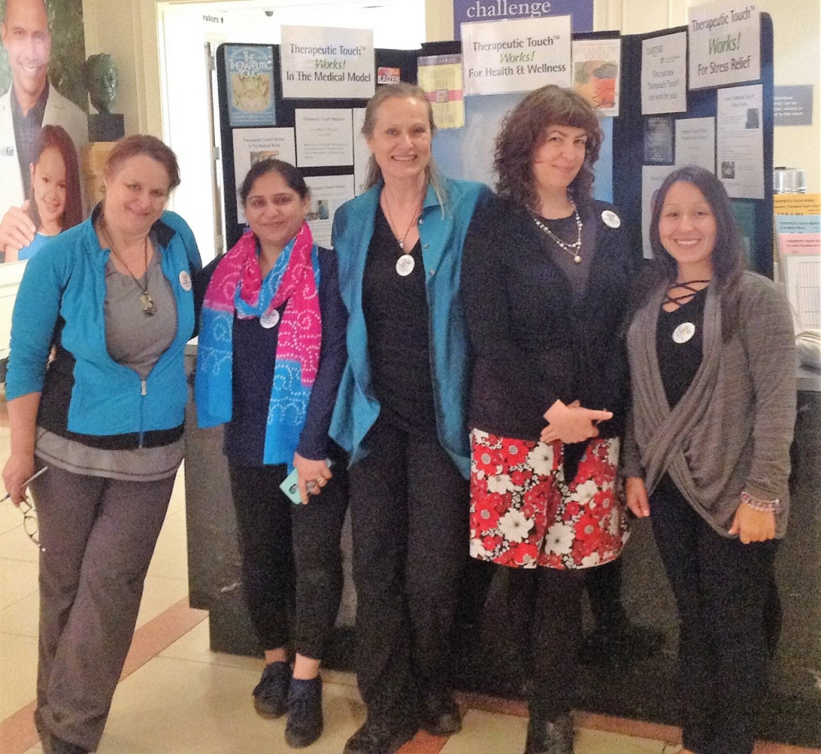
Sick Kids Hospital Toronto

Slide 17
2017 2018 2019
52 events
818 attendees
435 sessions offered
148.5 contact hours
22 new partners
158 practitioners
57 events ** 42 events
1118 attendees ** 775 attendees
845 sessions offered ** 500 sessions offered
143.5 contact hours ** 120 contact hours
27 new partners ** 22 new partners
212 practitioners ** 123 practitioners

Slide 18
So what is the overall impact in 3 years?
151 TTAW Events across Ontario
2,711 People Attended
1,780 TT Sessions Offered
412 Contact Hours = 10 weeks of TT sessions
71 New Community Partners gained across Ontario
493 Practitioner Volunteers contributed their skills

Slide 19
What did our membership say…
“The best resource was the willing volunteers.”
“We had more meaningful conversations with our participants this year.”
Members used Facebook to challenge other members to register an event.
“Consider hosting an event with the Alzheimer’s Society; they are great partners.”
“I found a local TT Branch to join.”
“We are now offering a TT program at our Family Health Unit for our clients.”
“This year, it involved a reflection on the practice of TT.”
A Senior Staff Physician reported that she could ‘feel the flow’ and took copies of all the handouts to distribute to her colleagues.

Slide 20
Questions: In groups of 3
What resonates with you about a Therapeutic Touch Awareness Week (TTAW)?
2. What would make it possible/sustainable in your community as well as in a larger arena?
3. My first step to building a TTAW in my community would be ____________.
.
.

Slide 21
Build on the ‘Living Legacy’ Share your ideas
Therapeutic Touch Awareness Week
Display & Resources can be found
In the TTNO office
Thank you
Deborah Gould R.N., Recognized TT Teacher

Slide 22
A week long provincial initiative
Hosted by TTNO members in 41 Communities
Thunder Bay Windsor Guelph Ottawa Haliburton Toronto Orangeville Caledon Gananoque Mississauga Etobicoke Huntsville Dwight Baysville Burk’s Falls Barrie Greenwood Oshawa Brampton Whitby Belleville Inglewood Bolton Simcoe Weston Kingston Picton Lasalle Dwight Pembroke Chatham Burlington Peterborough Owen Sound Christian Island Fergus Belwood Markham Strathroy Leamington Barry’s Bay

