Slide 1
Therapeutic Touch® A Recognized Complementary Therapy
Activate Your Inner Healer!
Notes:
Thank you [name of person who introduced you]

Slide 2
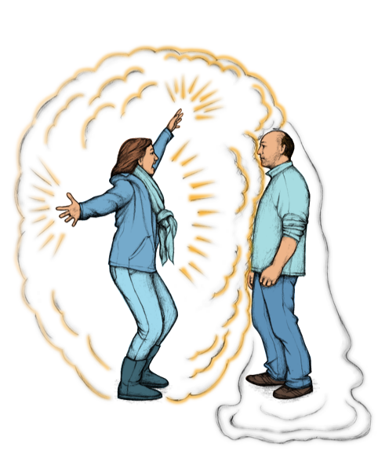
Did you ever notice…?
Notes:
Did you ever notice – sometimes when you walk into the cafeteria there is a strange buzz in the air. Or you walk into math class and just know even before talking to them that two of your friends are having an argument. What you are sensing is the energy around you. And we are affected by that energy.
[show graphic]
When there is tension in a room we feel that tension in our bodies. It’s similar to the tension we feel when we are preparing for a test, or having to give a presentation in class or wanting to ask someone to go out to the movies with us. Where do you feel tension in your body?

Slide 3
Did you ever notice…?
S0re Muscles
Tension Headaches
Stomach Upset
Or
Comfortable
Calm Relaxed
Notes:
These are some of the places we feel stress in our bodies.
Fortunately, there are also people or places that make us feel calm and peaceful [show 2nd half of slide]. Can you think of someone you met and immediately you felt comfortable around them. Or you walked into a place and began to relax. For me it’s …
What’s even better is that we can deliberately do things that will help us move towards calm and relaxation when we are feeling stressed and anxious.
Let’s try.

Slide 4
Take a Moment
This Photo by Unknown Author is licensed under CC BY-SA-NC
Notes:
We have all arrived here with lots on our minds. (jobs/lists/lunch/challenges) Let’s take a few moments to calm our minds.
(Offer a meditation: Invite class to allow the body to relax and settle into their chair/close or soften their eyes, bringing attention to the breath, noticing the flow in and out of the body. They may notice the monkey chatter of the mind will continue but acknowledging, then releasing it for now allows us to once again bring the focus back to this moment and the flow of the breath).
What was that like for you? Do you notice any difference between how you felt before the meditation and now?
A proven method of helping us to change our response to a situation is by being mindful. Another is being in nature – and because of the way our brains work, just by looking at these trees you will relax a little. The aim here is to quieten and calm the mind a little. The aim of meditation is to get us out of our heads and into the present moment.
Meditation and walking in nature are considered complementary therapies, practices that work to help a person take care of themselves in conjunction with conventional medicine.

Slide 5
What Complementary Therapies Do You Use?
Yoga
Massage
Acupuncture
Visualization
Reiki
Walk in nature
Music
Paint
Exercise
Nutrition
Notes:
What are some things you do or have heard about that people do to take care of themselves, what some people call self-care? (illicit responses)
These are all examples of practices that we can learn and use to complement medical treatment. The are offered in conjunction with conventional medical interventions to aid in the healing process. Often people do these practices as a preventative measure or to improve overall well-being.
The complementary therapy I’d like to talk about today is Therapeutic Touch.
One of the things that drew me to Therapeutic Touch is that it is one of the most research-based of the complementary therapies, used and taught in many health care settings, institutions and universities around the world.
If you had an accident and fractured your leg, you would want your physician to set the bone straight. Therapeutic Touch could support the healing, ease discomfort and promote sleep and rest. Research shows that fractures treated with Therapeutic Touch regularly can reduce healing times on xrays. (tell a TT story)
They offer ways to support our health and wellness through self care. (Note: outline your TT journey – first experiences/learning journey/uses & benefits).

Slide 6
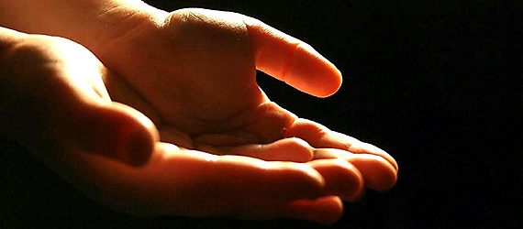
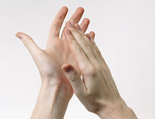
Time to play
“We don’t stop at our skin”
Dolores Krieger
This Photo by Unknown Author is licensed under CC BY-NC-ND
This Photo by Unknown Author is licensed under CC BY-SA
Notes:
Let’s see if we can get a sense of how Therapeutic Touch works.
Dolores Krieger, one of the founders of Therapeutic Touch, said we don’t st0p at our skin.
(Exercise: guide to sense and feel energy of their hands – feet flat on the floor, hands out front of the body palms facing, one foot apart, take a breath, move hands closer together but not touching, move gently in and out, soften fingers, ask for words to describe the felt or perceived sense. What you are feeling is your own energy field; remember it radiates out around our physical body. With practice it will become very palpable).

Slide 7
Therapeutic Touch Assumptions
Everything in the universe is energy
When we are healthy the energy flows freely in, through and out
With illness or injury the energy field is changed
This Photo by Unknown Author is licensed under CC BY-SA
Notes:
With practice we can begin to sense the field and changes that are happening. In nearly 50 years of studying this modality here is what we understand. Everything hasan electromagnetic energy field. We learned this in grade 10 science. Electromagnetism holds our atoms together. Einstein in his famous equation E=MC squared showed matter is energy.
With Therapeutic Touch we understand when we are healthy energy flows freely in and through the body. We are symmetrical – two arms, two legs, etc – and when we are healthy the energy is evenly distributed from side to side.
With illness the energy flow is disrupted or changed.
The Institute of HeartMath has determined that the magnetometer can measure the heart’s energy field radiating up to 8 – 10 feet around the body. Our intention with Therapeutic Touch is to help restore balance to the energy field.

Slide 8
Our Words have Energy
https://www.youtube.com/watch?v=Yx6UgfQreYY&t=5s
Notes:
Energy surrounds us all. How does the TV remote work, our cell phones or how does our body know what to do to heal a cut on our finger? We are a part of the energy field that is in all things. Even our words have energy as we can see in this short video.

Slide 9
Anyone Can Learn Therapeutic Touch
What do you need?
Compassionate heart
Willingness to help yourself and others
Desire to learn
This Photo by Unknown Author is licensed under CC BY-SA-NC
Notes:
Just like the young people in the video set the intention with the words they chose, anyone can learn Therapeutic Touch with the right intention.
All you need is a compassionate heart, a willingness to help others and yourself and a desire to learn.
It’s really that simple.

Slide 10
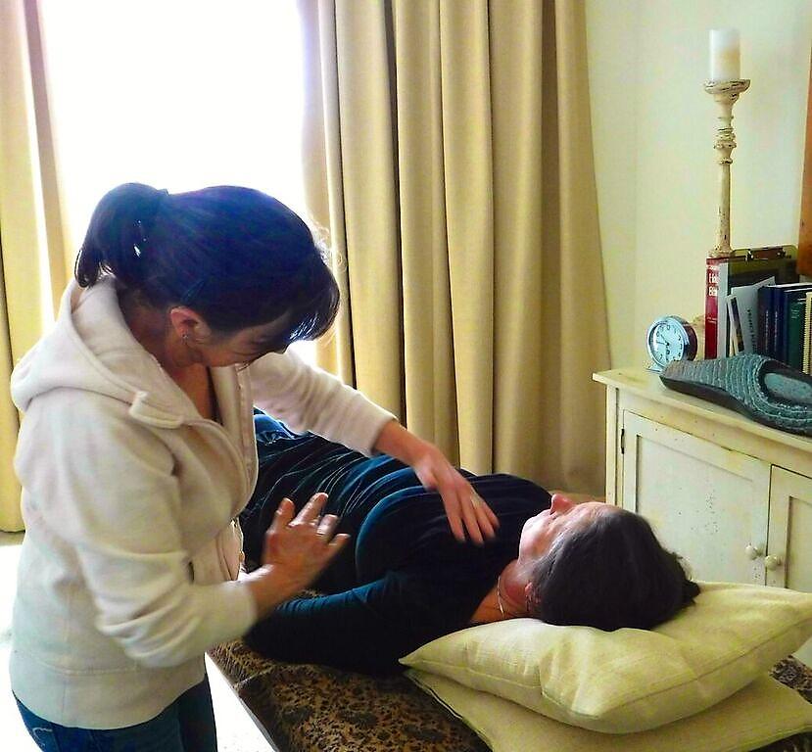
What is Therapeutic Touch?
Energy-based
Wholistic
Facilitates natural healing
Research verified
Notes:
So, what is Therapeutic Touch?
Therapeutic Touch is energy based. We know we are energy beings. Many of you were able to sense that by feeling the energy between your palms.
Therapeutic Touch is wholistic. It can affect all parts of our being. Though we most often feel the energy in our physical being, Therapeutic Touch also affects our mental, emotional and even spiritual selves. We know there is a connection, and science is making more and more clear the link between the physical, the emotional, the mental and the spiritual: how many times have you been mentally stressed about a test and gotten a stomach ache or headache? (use a personal example of how an emotional or mental stress affects your body, or visa versa)
Therapeutic Touch facilitates our body’s natural ability to heal itself. When you get a paper cut aside for being sure the wound is clean you don’t need to do anything – your finger repairs itself. Therapeutic Touch enhances this process (use a personal example of speeded healing of cut, burn or bone break)
And all of this has been backed by 50 years of research – including double blind studies that show its effectiveness is more than just the placebo effect.
The objective of Therapeutic Touch is to promote balance in all levels of our being. We have an energy body that is similar to our physical body. With very basic training, we become aware of the edges of the energy field at 4 – 6 inches (10 centimeters) from the body. As a practitioner our focus is on what we interpret as imbalances in that field. We are like anything else in nature. We like to feel even and balanced. It is our natural ability to heal.

Slide 11
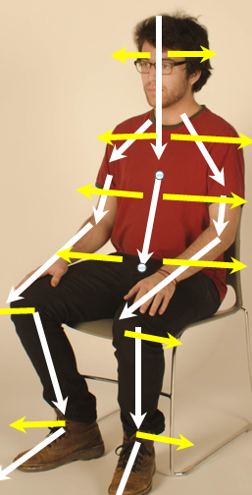
The Therapeutic Touch Session
Center
Assessment
Rebalancing
Ending
Reflect
Notes:
In a full Therapeutic Touch session these are the steps the practitioner will follow. The basic premise is that the practitioner uses their hands 4 to 6 inches off the body in the pattern shown in the picture. The practitioner sets an intention to move the energy from top to bottom, from centre outwards, and down and out through the fingers and bottom of the feet. Remember, a smooth, balanced energy flow helps our bodies to be at their best.
(If there is time, or the audience is appropriate, explain the TT process in more detail: These are the basic steps to offering a session. To center we find that still quiet place within ourselves and connect with our intention to restore balance. We are always promoting the flow of energy down the body and out the hands and feet. After assessing the field we use sweeping movements we promote an even flow that rebalances the field. The end of the session is when the field feels even and balanced. Reflecting on what you have learned after offering a session is key to learning how to improve your practice. (Exercise: So let’s try to do a small session on yourself. Choose either your arms or your legs. Pause to center (either with the breathe or just intending to quieten the mind for a moment) Sense the energy field over your arms or legs and if it seems there is a difference just sit with it for a moment. As in the prior diagram sweep through the field off the end of the fingers or down the legs and out the feet. Pause once again then finish and reflect on any changes. Note: ask class to share any feedback or make a few notes.

Slide 12
Spot the Difference
This Photo by Unknown Author is licensed under CC BY-ND
Notes:
We can sense the effect of moving the energy of our body even by focusing on one area at a time. This is great if you have a cut or a burn or bang your arm on your desk. Or a sports injury.
Sit upright in your chair. Let your left hand rest on your lap. Move your right hand about 4 to 6 inches along your left arm, moving from your should and down out past your finger tips. Do this a few times. As you move your right hand downward. Imagine it is moving the energy in your left arm down and out the tips of your left hand fingers. Your right hand is moving the energy down your left arm from your left shoulder, down your arm and out your fingers. After you have done this several times rest your right hand in your lap.
What do you notice between your left arm and your right arm? (illicit responses)
Now take a few moments to do the other side, moving your anergy down your right arm so you are in balance.

Slide 13
Effects of Therapeutic Touch
Promotes relaxation response
Reduces stress and anxiety
Helps in managing pain
Improves sleep
Facilitates body’s natural healing process
Fosters sense of well-being
Notes:
When this practice is done on the whole body there are measurable effects on a person’s physical, mental, emotional and spiritual well-being. These effects are evidence based on research and clinical experience. As individuals our bodies know what we need and we utilize the changes in our energy field based on that need.
There is a scaffold effect to a Therapeutic Touch session.
Almost immediately the receiver of a session will feel a relaxation response. If nothing else, a person will feel more relaxed after a session.
And as we relax, our levels of stress and anxiety decrease. We feel calmer and more at peace.
When relaxed and calm we are better able to manage any pain we are experiencing and our sleep is much deeper.
And all of these factors together means our natural healing process is able to work at it’s best – the natural mechanisms of our bodies can do what they were designed to do.
As this occurs, our sense of well-being is also improved. We feel better not only physically but mentally and emotionally as well.
(add a personal story of TT’s effectiveness)

Slide 14
What the Research Says
Dr. Dee Krieger
“Therapeutic Touch: The imprimatur of nursing”,
American Journal of Nursing, 5 (1975): 784-787.
50% of patients received Therapeutic Touch, 50% regular care. Patients receiving Therapeutic Touch - hemoglobin levels increased significantly.
Notes:
All of these effects are backed by research.
This was some of Dr. Krieger’s earliest research. The fact that the body responded by increasing hemoglobin levels (iron levels in the blood) offers concrete evidence of its efficacy. Hemoglobin carries oxygen to the cells further supporting ones wellbeing.
(Reference Research handout page – sent ahead of class to teacher) Research continues to be ongoing.

Slide 15
What the Research Says
Marta, Ilda, Sueli Baldan, Ani Berton, Michele Pavam, Maria da Silva.
“The effectiveness of Therapeutic Touch on pain, depression and sleep in patients with chronic pain: clinical trial”,
Revista da Escola de Enfermagem da USP (2010) 44(4): 1094-1102.
Therapeutic Touch was effective in decreasing pain intensity and depressive attitudes and symptoms, as well as improving sleep quality.
Notes:
Though this study focused on chronic pain, the results demonstrate that Therapeutic Touch can be effective in dealing with pain and the side effects of pain such as depression and sleeplessness. Just imagine how Therapeutic Touch could help you or your friends with a sports injury, or a burn or a cut.

Slide 16
Where Is Therapeutic Touch Offered?
Endorsed by Registered Nurses Association of Ontario –
Complementary Therapies Nurses’ Interest Group
Health Care Facilities
Hospital for Sick Children (Toronto)
Wellspring Chinguacousy Cancer Support Centre (Brampton)
Trilogy Retirement Home (Mississauga)
Guelph General Hospital (Guelph)
Hospices/end of life care
Bethell Hospice (Caledon)
Heart House Hospice (Mississauga)
Hospice Wellington (Guelph)
Taught by Recognized Teachers
This Photo by Unknown Author is licensed under CC BY-NC
Notes:
Because of the research and efficacy of Therapeutic Touch, it is widely practiced across Ontario and around the world. Some local examples include…
For those looking for careers in the medical field, Therapeutic Touch has been widely accepted and is supported by the medical community. It has proven to be a great asset for patients experiencing pain, interrupted sleep and rest as well as symptoms of stress and anxiety. The research has enhanced its value across all age groups.

Slide 17
Sensing colour can support the energy field
Blue:
Green
Yellow:
Notes:
As part of your self-care process, you can focus with an intention to move energy through a particular part of your body, as we did with our arms.
Or you can get a sense of a full Therapeutic Touch session with visualization and colour.
Close your eyes. Begin by imagining roots coming out of the bottom of your feet and going into the ground. In yoga and other practices they call this grounding. Then pick a colour that feels right for you today. It doesn’t matter what colour: blue, green, yellow, violet, orange. Imagine that colour coming into your body through the top of your head. Down through your head and neck to your shoulders. Imagine your colour moving down both arms and out of your fingertips. Now imagine the colour moving through our upper torso, down through the middle, through your stomach and lower back. Then past your hips, down the calves of your legs, your lower legs and out the bottom of your feet into the floor or ground. And for a few moments imagine your colour passing through your whole body, from your head al the way down and out through your fingertips and feet.
After you have done this for a few moments, come back to this room.
What was that like?
Does anyone have an ache or a pain? Perhaps a sports injury, headache, or just fatigue. Think about where it is in your body. Now by either sweeping your hand down over that area or just in your mind imagine the discomfort moving out the end of your hands or feet and away from your body. Continue sweeping over the entire body; head to foot. It begins that simply. As a beginner you can help yourself, your pets or your family. Practice is the key to learning about your energy field and how it feels.
Just as we are drawn to certain colours there is energy that can support our energy field. How do the colours blue/green and yellow change your field? To explore let’s try to see what you see, hear, smell or feel with each colour? Let’s find out: Close your eyes or soften your gaze and for a moment lets experience each of these colours. Note: read italics with pauses between to allow time to experience. ‘blue – imagine a cool lake or the many tones of blue in the sky’ pause ‘green - Imagine the newness of leaves and sprouts seeing the variations of their colour pause ‘imagine walking outside on a sun-filled day feeling its warmth and comforting embrace’ pause Was there a colour that was easier or more vivid? What senses felt easier or clearer? Did the colours resonate differently for you? (Blue – can promote feelings of peace, calm, quiet; Green – supports growth and healing, emotions that are heart-centered; Yellow – balances and energizes)

Slide 18
www.therapeutictouchontario.org
Notes:
Every year for the past 5 years Therapeutic Touch teachers, practitioners and branch members host events in their home communities to raise awareness of this simple yet profound modality. We invite you to take some time to learn more by checking out our website.
Are there any questions?
(after questions, allow a minute or two for closing comments)
(before moving to the next slide)
Pause to reflect on one thing that stood out for you today. What did you already know? How can you change or incorporate something you have learned today? Can you see how Therapeutic Touch could be a part of your own self-care?
I’d like to close with the words of Michael Jordan

Slide 19
‘Never say never, because limits, like fears,
are often just an illusion.’
Michael Jordan
Notes:
(read quote) Therapeutic Touch, like all complementary therapies, asks us to move beyond the limits of conventional medicine. But if we can look beyond those limits we will see that there is much we can do to support the healing of ourselves and others.

Slide 20
Thank You
Notes:
Pause to reflect on one thing that stood out for you today. What did you already know? How can you change or incorporate something you have learned today? It is understood that the relaxation response reduces our physical and emotional response to stress. This response happens in 2 – 4 minutes of offering a session. Can you see how Therapeutic Touch could be a part of your own self-care?

Slide 21
What the Research Says
Cancer
Jhaveri, Ankur, Stephen Walsh, Yatzen Wang, MaryBeth McCarthy, Gloria Gronowicz. “Therapeutic Touch Affects DNA Synthesis and Mineralization of Human Osteoblasts in Culture.” Journal of Orthopaedic Research 26.11 (2008): 1541-1546. http://www.ncbi.nlm.nih.gov/pubmed/18524012
In the cultures receiving TT growth of the bone building cells was enhanced while growth of the bone cancer cells was inhibited.
Aghabati, Nahid, Eesa Mohammadi and Zahra Esmaiel. “The Effect of Therapeutic Touch on Pain and Fatigue of Cancer Patients Undergoing Chemotherapy.” eCAM 7. 3 (2010): 375-381. http://www.ncbi.nlm.nih.gov/pmc/articles/PMC2887328/?tool=pubmed
“To examine the effect of therapeutic touch (TT) on the pain and fatigue of the cancer patients undergoing chemotherapy ... The TT(significant) was more effective in decreasing pain and fatigue of the cancer patients undergoing chemotherapy than the usual care group, while the placebo group indicated a decreasing trend in pain and fatigue scores compared with the usual care group”(375).
Reduction in Stress and Anxiety
◊ Kramer, N. A. (1990). Comparison of Therapeutic Touch and casual touch in stress reduction of hospitalized children. Pediatric Nursing, 16(5), 483-485.
◊ Hawranik, Pamela, Pat Johnston and Judith Deatrich. “Therapeutic Touch and Agitation in Individuals with Alzheimer’s Disease.” Western Journal of Nursing Research 30.4 (2008): 417-434. Print.
Improves Sleep
◊ Braun, C., Layton, J., & Braun, J. (1986). “Therapeutic Touch improves residents' sleep.” American Health Care Association Journal, 12(1), 48-49.
Efficacy
Newshan, Gayle and Dona Schuller-Civitella. “Large Clinical Study Shows Value of Therapeutic Touch Programs.” Holistic Nursing Practice 17. 4 (2003): 189-192. http://www.ncbi.nlm.nih.gov/pubmed/12889546
Representing the largest published sample size of therapeutic touch (TT) outcomes to date, data from this continuous quality improvement (CQI) clinical study suggest that TT, when provided in the clinical setting promotes comfort, calmness, and well-being among hospitalized patients. In addition, patients are highly satisfied with TT. The newly developed Patient Satisfaction Survey and TT Performance Improvement Tool provide an effective means by which to evaluate a TT program” (189).
Notes:
Handouts for class ahead of presentation. This document can be printed by the teacher or sent electronically. Suggest also send contact information and Therapeutic Touch pamphlets enough for class.

