Slide 1
Permission is given to members of the Therapeutic Touch Network of Ontario to use this PowerPoint presentation and to modify slides for their group. If adding personal photos, signed permission is required.
Permission is given to the TTNO to use the audio and video testimonials used in this PowerPoint.
Alison Cooke, BSA, BEd,RT, QTTP
Jim Metson, BA, BEd,RT

Slide 2
Therapeutic Touch® A Recognized Complementary Therapy
Healing in the 21st Century
Notes:
This slide show, an introduction to Therapeutic Touch designed for hospice, was created by Alison Cooke with the help of Jim Metson. If you have any questions about this slide show feel free to contact Alison at adcooke141@gmail.com
- This slide show has been prepared for a minimum one hour presentation – usually
1 ¼ to 1 ½ hours. The presentation includes several experiential exercises. If you don’t do them those slides can be removed. At the end of the slide show I do a short mini-session and then answer questions. The audience is encouraged to ask questions throughout the presentation as well.
- The slides can be moved around – and some deleted for a shorter presentation. Each time I do this presentation I make changes according to my time frame! Please add only slides with photos for which you have permission
Text - What are some things you do or have heard about that people do to take care

Slide 3
What Complementary Therapies Do You Use?
Yoga
Massage
Acupuncture
Visualization
Reiki
Meditation
Walk in nature
Music
Paint
Art
???
Notes:
What are some things you do or have heard about that people do to take care of themselves, what some people call self-care? (illicit responses)
These are all examples of practices that we can learn and use to complement medical treatment. The are offered in conjunction with conventional medical interventions to aid in the healing process. Often people do these practices as a preventative measure or to improve overall well-being.
The complementary therapy I’d like to talk about today is Therapeutic Touch.
One of the things that drew me to Therapeutic Touch is that it is one of the most research-based of the complementary therapies, used and taught in many health care settings, institutions and universities around the world.
If you had an accident and fractured your leg, you would want your physician to set the bone straight. Therapeutic Touch could support the healing, ease discomfort and promote sleep and rest. Research shows that fractures treated with Therapeutic Touch regularly can reduce healing times on xrays. (tell a TT story)
They offer ways to support our health and wellness through self care. (Note: outline your TT journey – first experiences/learning journey/uses & benefits).

Slide 4
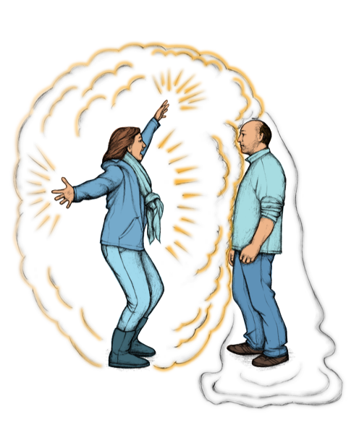
Did You Ever Notice?
“We Don't Stop At Our Skin.” Dolores Krieger
Notes:
Note that when we enter a room we can “read” the room.
Someone coming close you can tell if you’d like to know them better …. Or not.

Slide 5
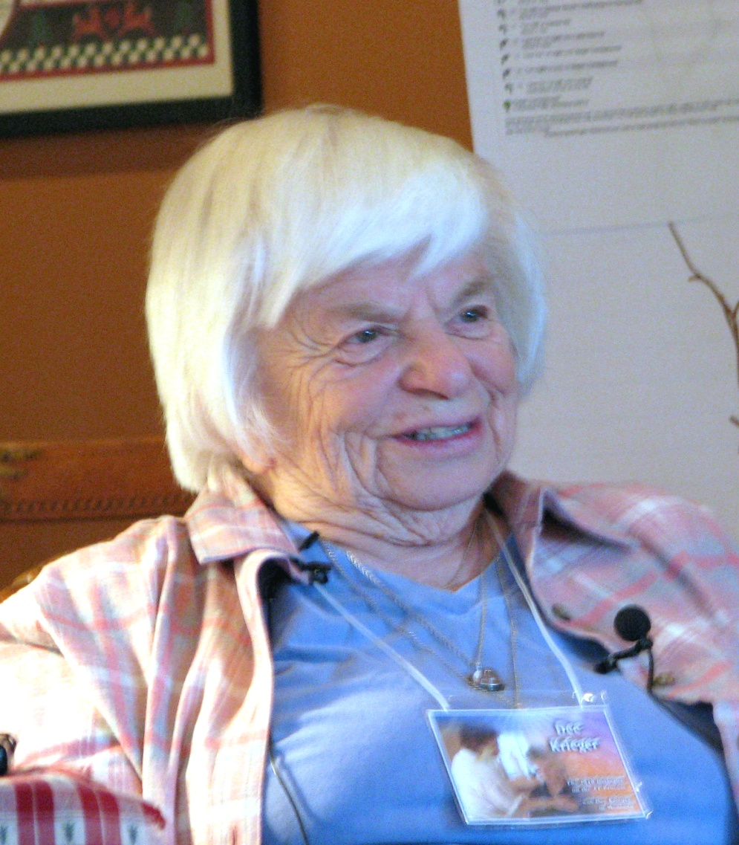
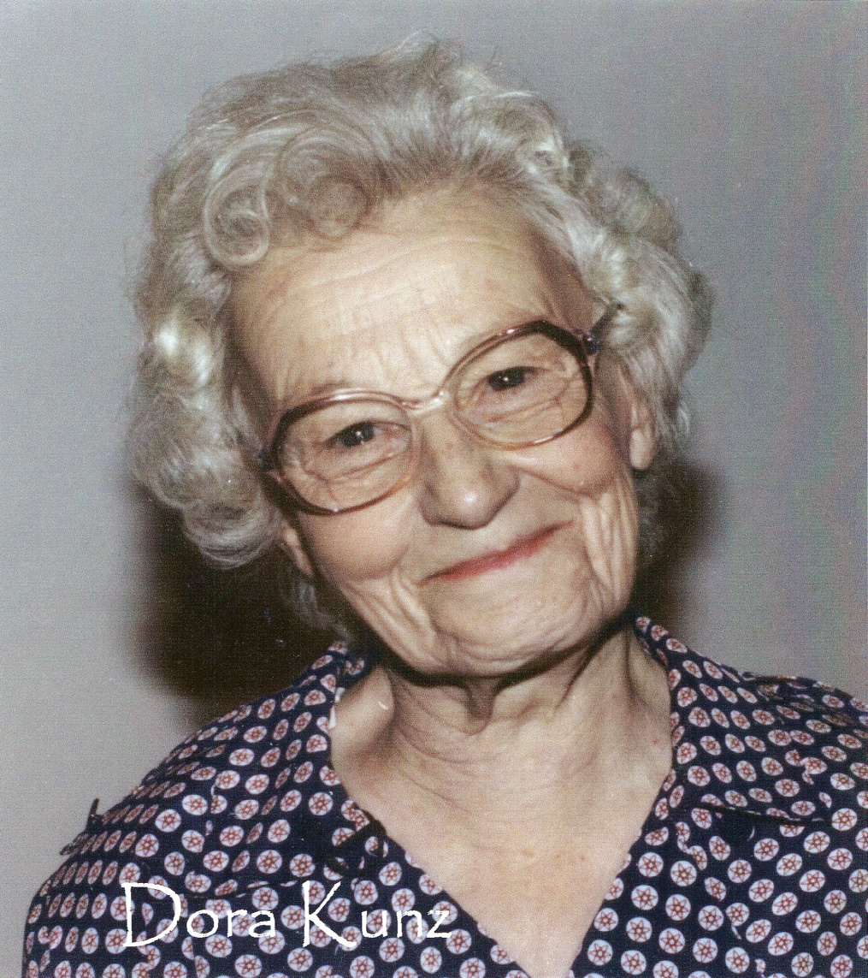
History of Therapeutic Touch
Dr. Dolores Krieger Dora Kunz
Notes:
Developed in the early 1970s. Dr. Kreiger – professor of nursing at New York University
Dora Kunz – intuitive healer

Slide 6
Who Can Learn Therapeutic Touch®?
All who have:
a compassionate heart
a willingness to help themselves and others
the desire to learn
GerdAltmann@Pixabay

Slide 7
How Do We Begin?
By quieting the Monkey Chatter of the Mind
Pixabay
Notes:
This is where I do the simple breathing exercise – noticing breath as it passes over the nostrils – cool on inbreath, warm on out breath. For a few minutes.
How did that feel? – calm, peaceful – this is the feeling we bring to our clients – it puts us in the moment, ready to deal with whatever comes up in the session
A tool for stress management they can take home from this presentation

Slide 8
Centering – the Doorway to Therapeutic Touch
Bringing body, emotions, mind, and spirit to a quiet focussed state of consciousness
Being in the “present moment” we can be truly supportive to the palliative care client.
Gives us the ability to cope with whatever our encounter with the client brings us.
Centering is the key to our compassion
Thgmueller@pixabay

Slide 9
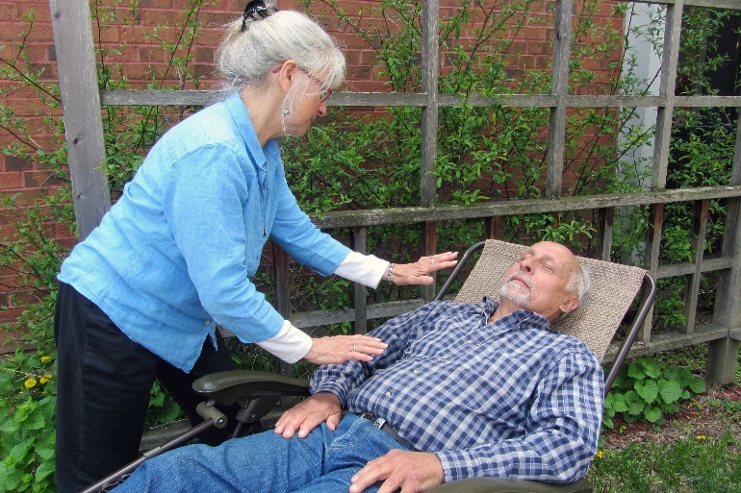
What is Therapeutic Touch?
A gentle, energy-based healing technique
Holistic
Evidence-based
Uses our hands as a focus for facilitating the healing process
Complementary, integrative,
non-invasive

Slide 10
Therapeutic Touch Assumptions
Everything in the universe is energy
When we are healthy energy flows freely in, through and out
With illness or injury the energy field is changed
This Photo by Unknown Author is licensed under CC BY-SA

Slide 11
Did You Ever Notice?
“We Don't Stop At Our Skin.” Dolores Krieger
Notes:
Here you can do the exercise where they feel their own energy field between their hands as they move their palms slowly close and then apart. Note space between, what it feels like and what parts of their hand are most sensitive to the energy

Slide 12
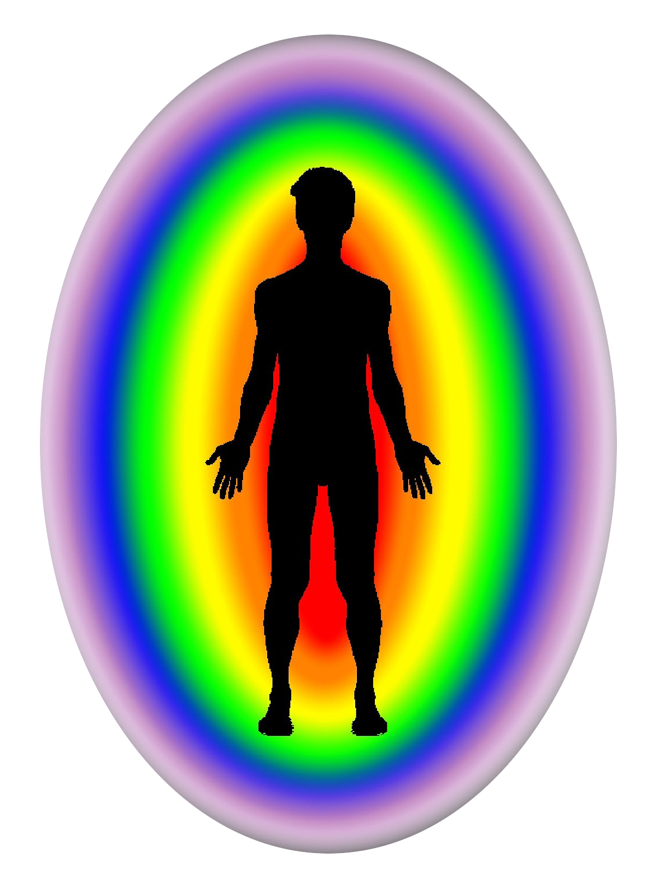
Energy Fields
Notes:
Usual picture you see of energy fields – they look like icing on a cake, different layers

Slide 13
The Human Energy Fields
Body
Emotions
Mind
Creative Spirit
Physical
Notes:
Physical – densest energy

Slide 14
The Human Energy Fields
Body
Emotions
Mind
Creative Spirit
Etheric
Notes:
Actually all fields start at the core of our being.
Etheric - Usually 4-6” out from body

Slide 15
The Human Energy Fields
Body
Emotions
Mind
Creative Spirit
Emotional
Notes:
Usually about to elbow but very elastic – expands with high emotions like love or anger

Slide 16
The Human Energy Fields
Intellectual
Body
Emotions
Intellectual
Creative Spirit
Notes:
Often called the mental field

Slide 17
The Human Energy Fields
Spiritual/
Intuitive
Body
Emotions
Mind
Creative Spirit

Slide 18
The Human Energy Fields
Spiritual/
Intuitive
Intellectual
Body
Emotions
Mind
Creative Spirit
Emotional
Etheric
Physical
Notes:
So we see the fields are not “layers” like icing on a cake – all share the same space at our core, with some extending further than others

Slide 19
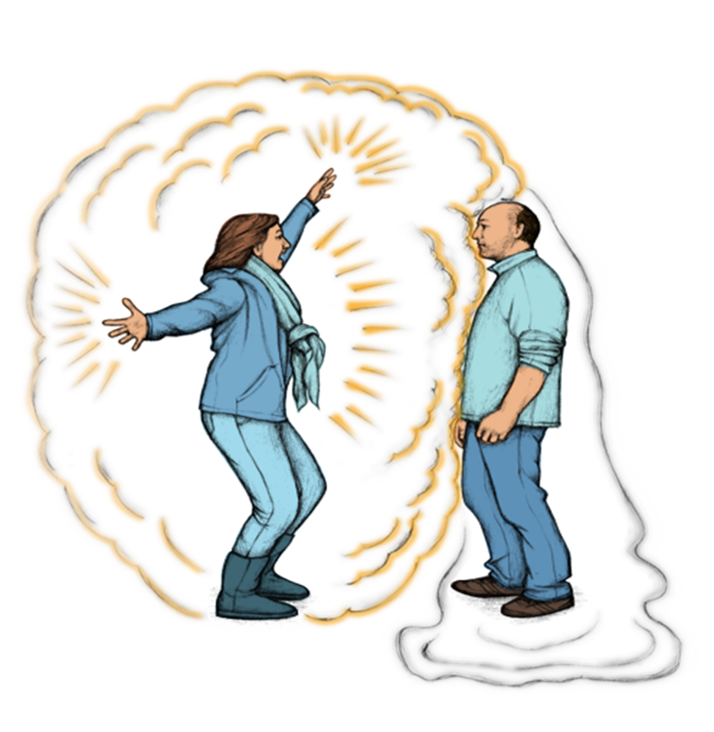
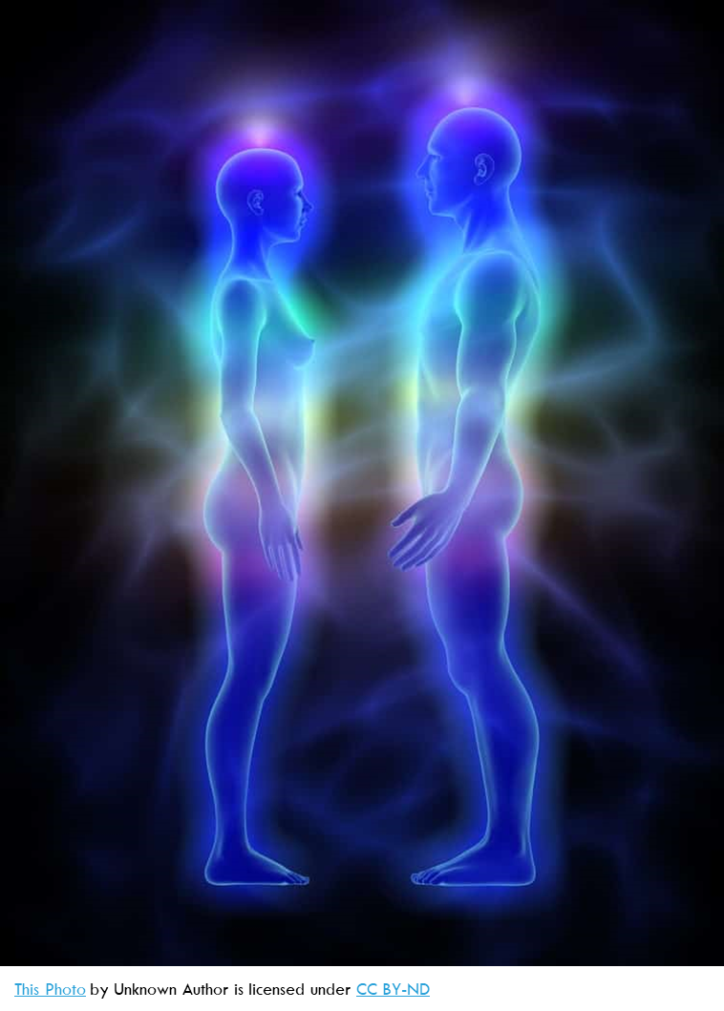
Our Fields Share the Same Space
Notes:
All fields share the same space
All originate in the core of our being

Slide 20
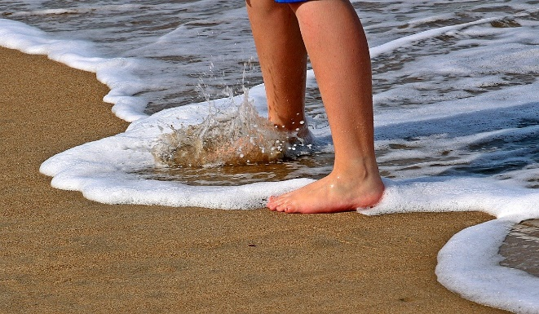
Grounding for Ourselves
Facilitates the flow of energy in, through and out
Anchors us to our environment in time and space
Pixabay
Present in our body
Connected to the earth
Provides resilience and strength
Pexels.com
Notes:
Exercise – stand with partner – one person [wind] gently pushes partner, then partner grounds and centers, when gently pushed notice the difference
For Ourselves -being "grounded" means that you're present in your body and connected with the earth. When you're grounded, you allow yourself to feel centered and balanced no matter what's going on around you. If you aren't grounded, you're like a leaf in the wind: very vulnerable and thrown off balance very quickly.
[

Slide 21
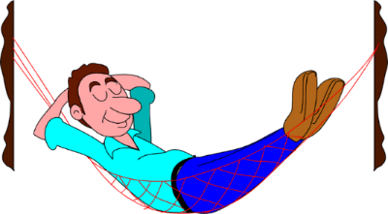
Benefits of Therapeutic Touch – From Research and Clinical Experience
Holistic, affecting your body, emotions, mind and creative spirit
Relaxation Response
Reduce Anxiety & Stress – a sense of calm, safety, wonder
Manage Pain
Sleep More Easily
Feel better
PinClipart.com
Clipart.ca
Notes:
Cascade of effects starting with relaxation response

Slide 22
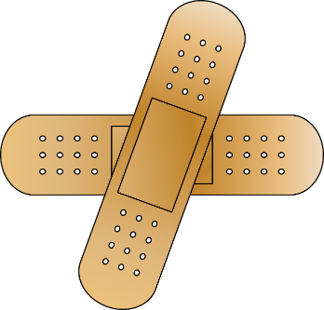
Added Benefits
Comfort in the dying process
First Aid
Empowering
TT complements any medical care that your health care provider is prescribing
Clipart.com
Clipart.com
JphnHain@pixabay
Clipart.com

Slide 23
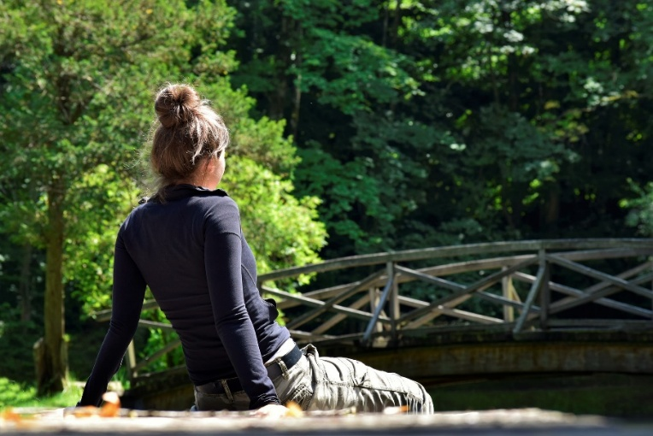
Self-Compassion
The focus is for you to take time for yourself.
How?
A meditation for self-compassion
Guided imagery for creating a Peaceful Place
Encouragement to journal
The importance of allowing yourself to ask for and graciously receive help
Silviarita@pixabay
Notes:
It’s important to take care of yourself.

Slide 24
Therapeutic Touch & Palliative Care
Compassion
Unconditional love
Transformational
“Without compassion, whatever else one may do, it is not Therapeutic Touch.”
Dolores Krieger
Our healing presence - we project our inner peace and compassion making contact at the deepest level of our client’s being
Pixabay
Notes:
We also bring a willingness to confront ourselves and to accept vulnerability

Slide 25
Therapeutic Touch & Palliative Care
Centered and Grounded
Quiet mind = calm presence
Relaxed, aware, fully present
Connect at the deepest level as healing partners
Intention
Restore order, balance and harmony to the field
Unattached to outcome
Pixabay
Notes:
We also bring a willingness to confront ourselves and to accept vulnerability

Slide 26
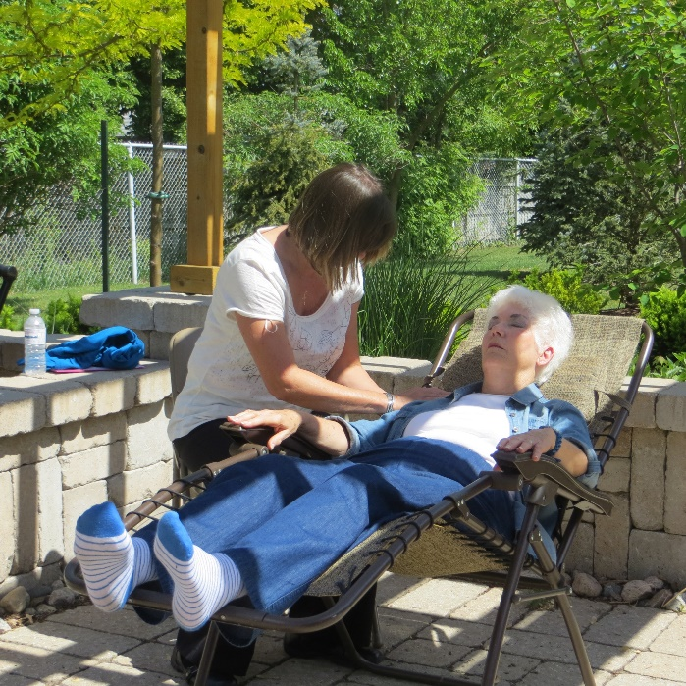
Hospice Palliative Care aims to | Therapeutic Touch
Relieve suffering | Promotes relaxation & eases stress
Improve the quality of living and dying | Helps manage pain and other symptoms, Fosters a sense of well-being
Address physical, psychological, social, spiritual, practical issues | Focusses on restoring balance in all aspects of the human energy field: body, emotions, mind and spirit
Enhance personal, spiritual growth and self-actualization | Offers opportunities for self-growth
TTNO
Notes:
Definition of Hospice Palliative Care
From A Model to Guide Hospice Palliative Care: Based on National Principles and Norms of Practice (2002) Canadian Hospice Palliative Care Association
See http://www.chpca.net/general_information.html
Hospice palliative care aims to relieve suffering and improve the quality of living and dying.
Hospice palliative care aims to:
· treat all active issues
· prevent new issues from occurring
· promote opportunities for meaningful and valuable experiences, personal and spiritual growth, and self-actualization.

Slide 27
Let’s Hear from the Volunteer Coordinator
Kat – the Volunteer Coordinator at
Bethell Hospice, Inglewood Ontario

Slide 28
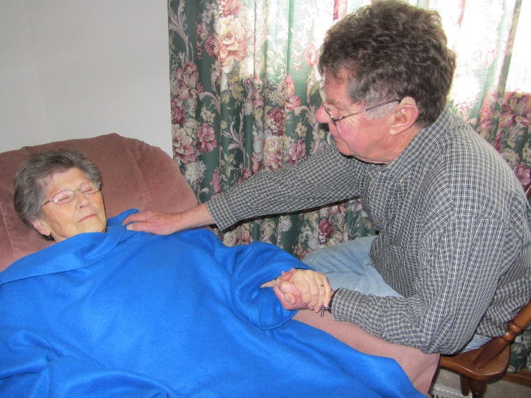
A question That May Be Asked
Will it hurt?
Therapeutic Touch is ever so gentle.
Practitioners are taught to be gentle and to give short treatments.
Photo by Alison Cooke

Slide 29
A Question That May Be Asked
What will I feel?
Relaxation
Calming
Your anxieties and worries will
“float away”
A sense of stillness
A sense of well-being
A sense of wonder
Sippakorn Yamkasikorn @ pixabay

Slide 30
What the Research Says
Dr. Dee Krieger
“Therapeutic Touch: The imprimatur of nursing”,
American Journal of Nursing, 5 (1975): 784-787.
50% of patients received Therapeutic Touch, 50% regular care. Patients receiving Therapeutic Touch - hemoglobin levels increased significantly.
Notes:
All of these effects are backed by research.
This was some of Dr. Krieger’s earliest research. The fact that the body responded by increasing hemoglobin levels (iron levels in the blood) offers concrete evidence of its efficacy. Hemoglobin carries oxygen to the cells further supporting ones wellbeing.
(Reference Research handout page – sent ahead of class to teacher) Research continues to be ongoing.

Slide 31
What the Research Says
Olson, M., & Sneed, N.
“Anxiety and Therapeutic Touch”,
Issues in Mental Health Nursing, (1975) 16(2), 97-108.
Consistent with previous studies, perceived anxiety seems to decrease after TT in highly anxious persons.
Stressed-AI-Magic Studio

Slide 32
What the Research Says
Marta, Ilda, Sueli Baldan, Ani Berton, Michele Pavam, Maria da Silva.
“The effectiveness of Therapeutic Touch on pain, depression and sleep in patients with chronic pain: clinical trial”,
Revista da Escola de Enfermagem da USP (2010) 44(4): 1094-1102.
Therapeutic Touch was effective in decreasing pain intensity and depressive attitudes and symptoms,
as well as improving sleep quality.
Notes:
Though this study focused on chronic pain, the results demonstrate that Therapeutic Touch can be effective in dealing with pain and the side effects of pain such as depression and sleeplessness. Just imagine how Therapeutic Touch could help you or your friends with a sports injury, or a burn or a cut.

Slide 33
Words from a Palliative Care Client
“Unless you have been through a physical crisis in your life, you cannot understand the spiritual value that this therapy provides …
The depression that many of us feel is alleviated. We are comforted in our walk through the darkness.”
Marilyn Wright
Belleville, ON
Pixabay

Slide 34
Let’s Hear from a Volunteer
David – a Volunteer at Bethell Hospice, Inglewood Ontario

Slide 35
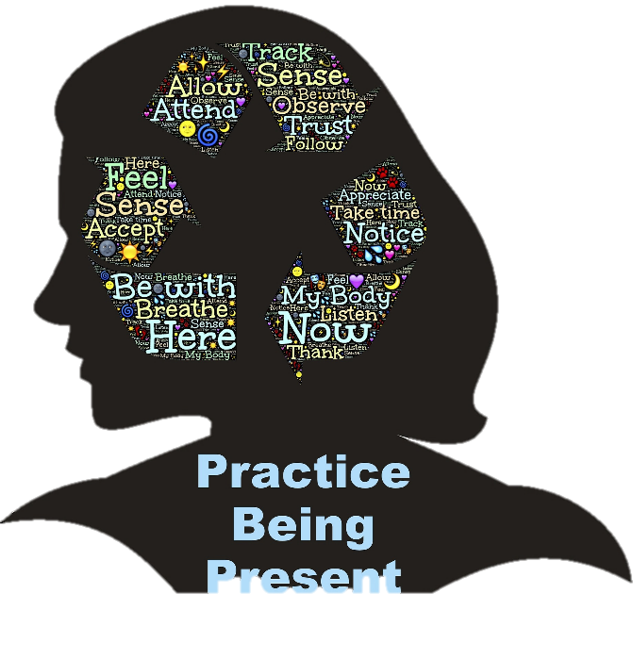
The Gifts of Centering
For the hospice client
Because we are centered we can really listen to their needs.
Need to know they will not be abandoned
Need for the opportunity to express themselves
Need for hope
JohnHains@pixabay

Slide 36
The Gifts of Centering
For the family
Because we are centered, we can really listen to family needs.
Someone to talk to – to show the real “me” that may not be strong
We listen as they work through questions such as
“Who have I been?”
“Who am I now?”
“Who am I becoming?”
JohnHains@pixabay

Slide 37
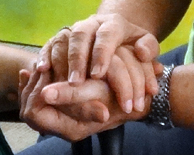
The Gifts of Therapeutic Touch
For the hospice client
Their quality of life is improved
They are more relaxed
Have less pain
Are better prepared for death
With Permission Paula Neilson

Slide 38
What About Us?
The relaxation techniques learned in the workshops help us remain calm, centered and grounded in all areas of our life.
We can easily do Therapeutic Touch on ourselves. This has a huge impact on compassion fatigue - we just don’t get it.
We are more patient with others, understand ourselves better, see more beauty in the world around us and always carry with us a sense of well-being.
Jill Wellington@pexels

Slide 39
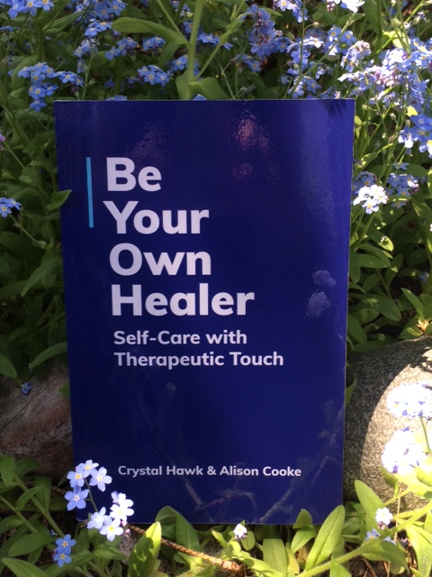
Be Your Own Healer: Self-Care with Therapeutic Touch
Photo by Paula Neilson

Slide 40
Self-Compassion
In the self-care classes the focus is on self-compassion, taking more time for yourself.
How?
Meditations for self-compassion
Guided imagery for creating a Peaceful Place
More centering meditations
Empowering Poems
Encouragement to journal
The importance of allowing yourself to ask for and graciously receive help
Silviarita@pixabay

Slide 41
Self-Care
Centering
Grounding
Self-Therapeutic Touch
Intention
Unattachment to outcome
Therapeutic Touch for First Aid
Photo by Alison Cooke

Slide 42
Self-Care Testimonial
Since learning TT for Self-Care, my life has changed for the better. TT is a technique that is quite frankly essential for self-care and living a healthy & more productive life. There are so many mysteries beyond our physical world, but the ability to heal yourself doesn't have to be one of them … I use TT daily, yes daily! For aches and pains, and even just to balance myself when nothing seems to be wrong. Elizabeth Robinson
Be Your Own Healer: Self-Care with Therapeutic Touch, pg 4

Slide 43
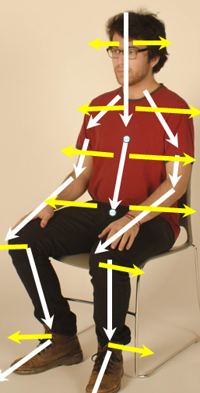
The Therapeutic Touch Session
Center
Assessment
Rebalancing
Ending
Reflect
TTNO
Notes:
In a full Therapeutic Touch session these are the steps the practitioner will follow.
Here you can do a demonstration TT session.
They can then try clearing their arm of leg or even follow you as they clear their whole field. Read your audience to know what will work best.
What did they notice in the demonstration or when doing TT on themselves?

Slide 44
A Question for You
What will you take home from this introduction to Therapeutic Touch?

Slide 45
Your Opportunities
Therapeutic Touch for Family and Friends
Foundations of Therapeutic Touch
[16-18 hours]
Therapeutic Touch for Hospice
Transpersonal Nature of Therapeutic Touch
[16-18 hours] usually 6 months of practice
after Foundations
Recommended to attend a TTNO Branch
TT for Self-Care
8-9 hours
“You will be forever changed.”
Dolores Krieger
Notes:
Make sure to have a call to action near the end of your presentation

Slide 46
Healing is about becoming whole; it is “not just about the body physical. Wholeness is harmony of body, emotion, mind and spirit.”
Janet Quinn
MVenter-Pexels

Slide 47
Your Questions?

